Slide 1


Project (COC6919) Presentation
Topic: Customer Churn Prediction using Machine Learning
Presented By:-
Rupesh Varshney
Faculty No :-25CPMEA113
M.Tech 1st Year CSE
Under the Supervision of :-
Prof. Ash Mohammad Abbas
Professor, Dept. Of Computer Engg.
ZHCET ,AMU Aligarh

Slide 2
INDEX
Introduction
Problem Background
Literature Review
Research Gap
Solution
Methodology
Results
Applications
Conclusion
References

Slide 3
Introduction
In today’s hyper-competitive market, businesses fail due to lack of understanding of customers.
Growth is not just about acquiring new users, but about retaining the right Customer.
Modern organizations generate massive customer data, yet struggle to convert it into actionable insights.
So, Customer Churn Prediction empowers businesses to move from guesswork to data-driven insights.
Research show that, Acquiring a new Customer can cost 5-7x more than retaining an existing customer.

Slide 4
Problem Background
In today’s competitive market, Customers frequently switch to competitors due to better pricing, improved services, or enhanced customer experience. This customer attrition, known as churn, leads to revenue loss and increased operational costs.
Business React When:
The customer is already about to leave.
Unable to handle large amounts of data.
Lack of understanding of customer behavior.
As a result, There is a need for an intelligent and data-driven approach that can:
Predict potential churners at an early stage
Detect hidden behavioral patterns
Analyze historical customer data

Slide 5
Literature Review
Early Approaches: Statistical Models
Initially, churn prediction relied on traditional statistical techniques such as:
Guess work
Used historical data to estimate probability of churn
learn patterns from customer data
Although widely used, these approaches struggle with:
Non-linear relationships
Limited in handling large dataset

Slide 6
Research Gap
Existing Customer Churn Prediction models primarily focus on achieving high accuracy, but overlook real-world business & Customer needs.
Model Drawbacks:-
Ignore early-stage churn signals hidden in Dataset.
Model depend only on past data, not changing behavior.
Decision are not taken at the right time.

Slide 7
Solution
Recent studies suggest that future progress in churn prediction lies in:
Hybrid Models — combining multiple algorithms for better accuracy and prediction.
Decision Tree Classifier
Random Forest Classifier
XGBoost Classifier
LightGBM Classifier

Slide 8
Methodology
1. Data Acquisition
The first stage of the system involves collecting customer data from available sources. This data may include:
Customer demographic details
Account information
Service usage patterns
Billing and payment details
The collected raw data is stored in the form of a dataset (typically CSV format). This dataset acts as the input for further processing and analysis.

Slide 9
Methodology
2. Data Preprocessing
The raw dataset is not directly suitable for machine learning models, so it undergoes preprocessing. This step ensures data quality and consistency.
Handling missing values
Removing irrelevant attributes (e.g., customer ID)
Encoding categorical variables into numerical format
Feature scaling and normalization
After preprocessing, the data becomes clean and structured, ready for model training

Slide 10
Methodology
3. Feature Selection
In this stage, important features that influence customer churn are selected from the cleaned dataset.
Irrelevant or redundant features are removed
Only meaningful features are retained
This improves model performance and reduces complexity
The output of this step is a set of relevant features used for training models.

Slide 11
Methodology
4. Model Building
The system builds multiple machine learning models using the selected features.
Decision Tree Classifier
Random Forest Classifier
XGBoost Classifier
LightGBM Classifier
Each model learns patterns from the data and tries to classify the customers.

Slide 12
Methodology
5. Data Splitting
Before training, the dataset is divided into:
Training Data (80%) – used to train models
Testing Data (20%) – used to evaluate models
This ensures that the model is tested on unseen data.

Slide 13
Methodology
6. Training and Testing
Models are trained using the training dataset
Predictions are made on the testing dataset
Performance is evaluated using metrics such as:
Accuracy Score
Confusion Matrix
This step ensures that the model generalizes well.

Slide 14
Methodology
7. Classification (Prediction Stage)
After training, the system performs classification:
Will Churn (1) → Customer likely to leave
Will Not Churn (0) → Customer likely to stay
This is the core output of the system.

Slide 15
Methodology
8. Model Evaluation and Comparison
The performance of all models is compared to identify the best-performing model.
Accuracy scores are compared
Confusion matrices are analyzed
Model | Accuracy | TP (%) | FN (%)
Stacking (MultiModel) | 0.87 | 43.25% | 6.52%
XGBoost | 0.83 | 42.5% | 6.91%
LightGBM | 0.83 | 42.3% | 6.67%
Random Forest | 0.79 | 42.2% | 7.54%
Decision Tree | 0.77 | 39.7% | 10.00%

Slide 16
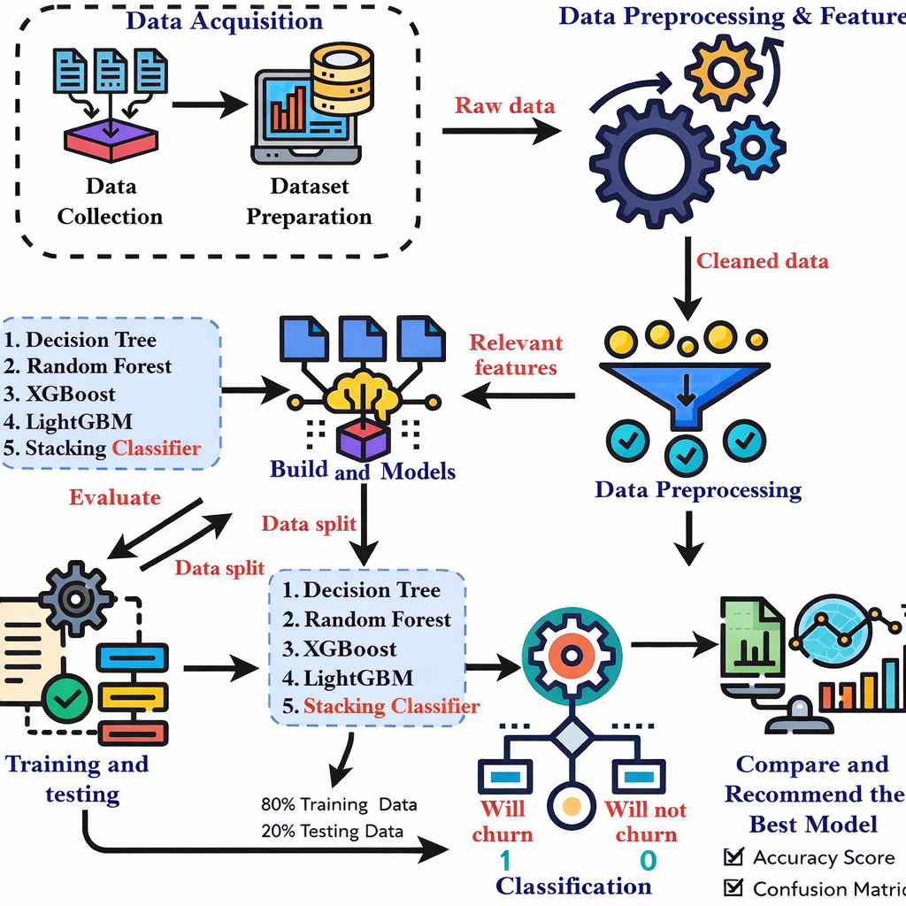
Overall Project Workflow

Slide 17
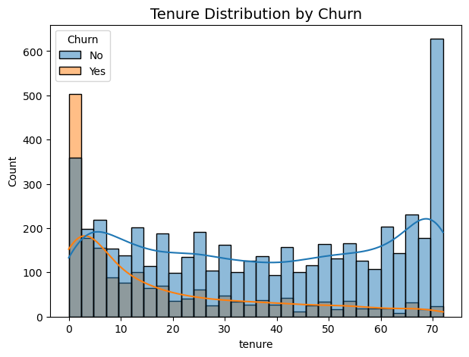
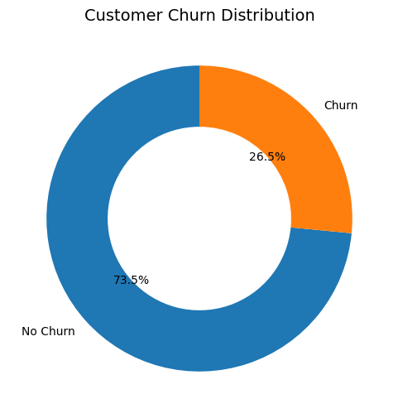
Results

Slide 18
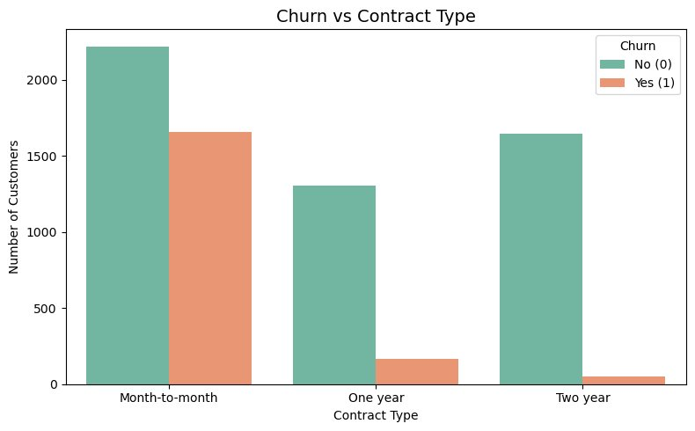
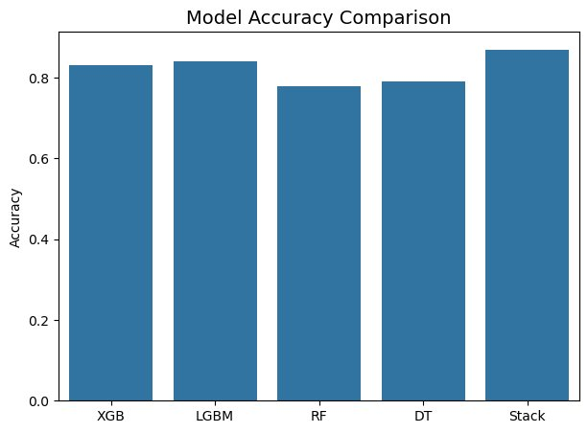

Slide 19
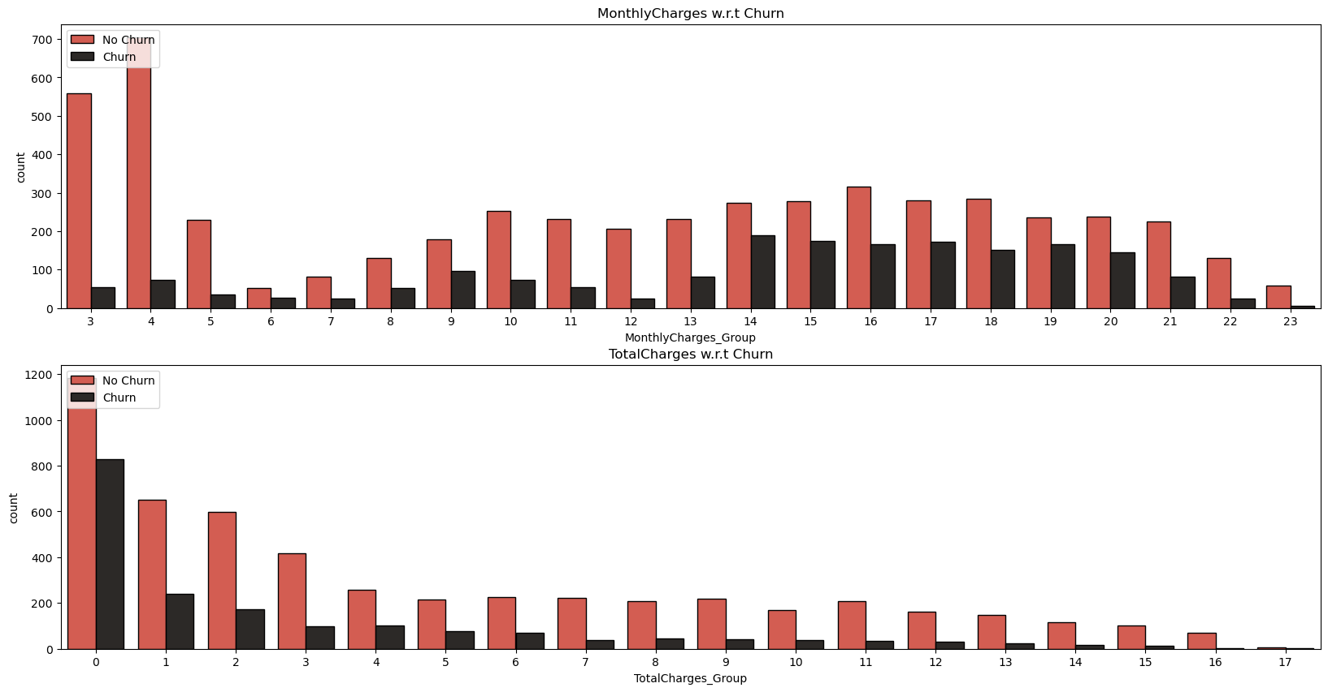

Slide 20
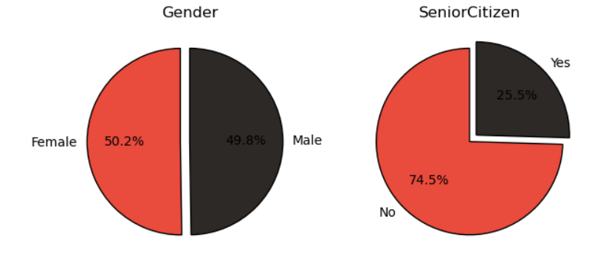
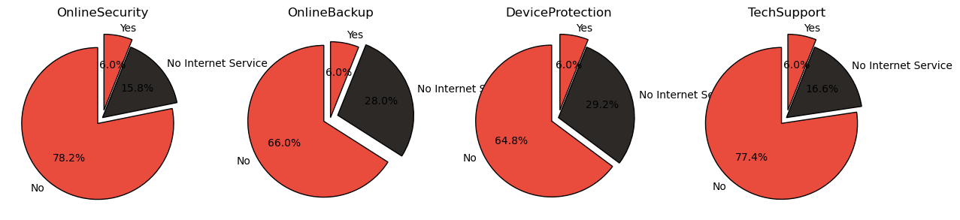

Slide 21
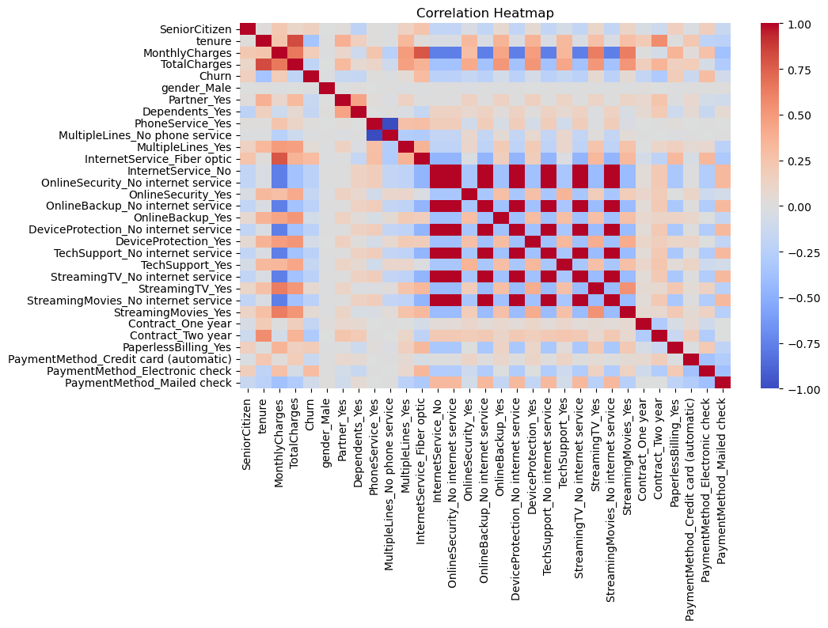

Slide 22
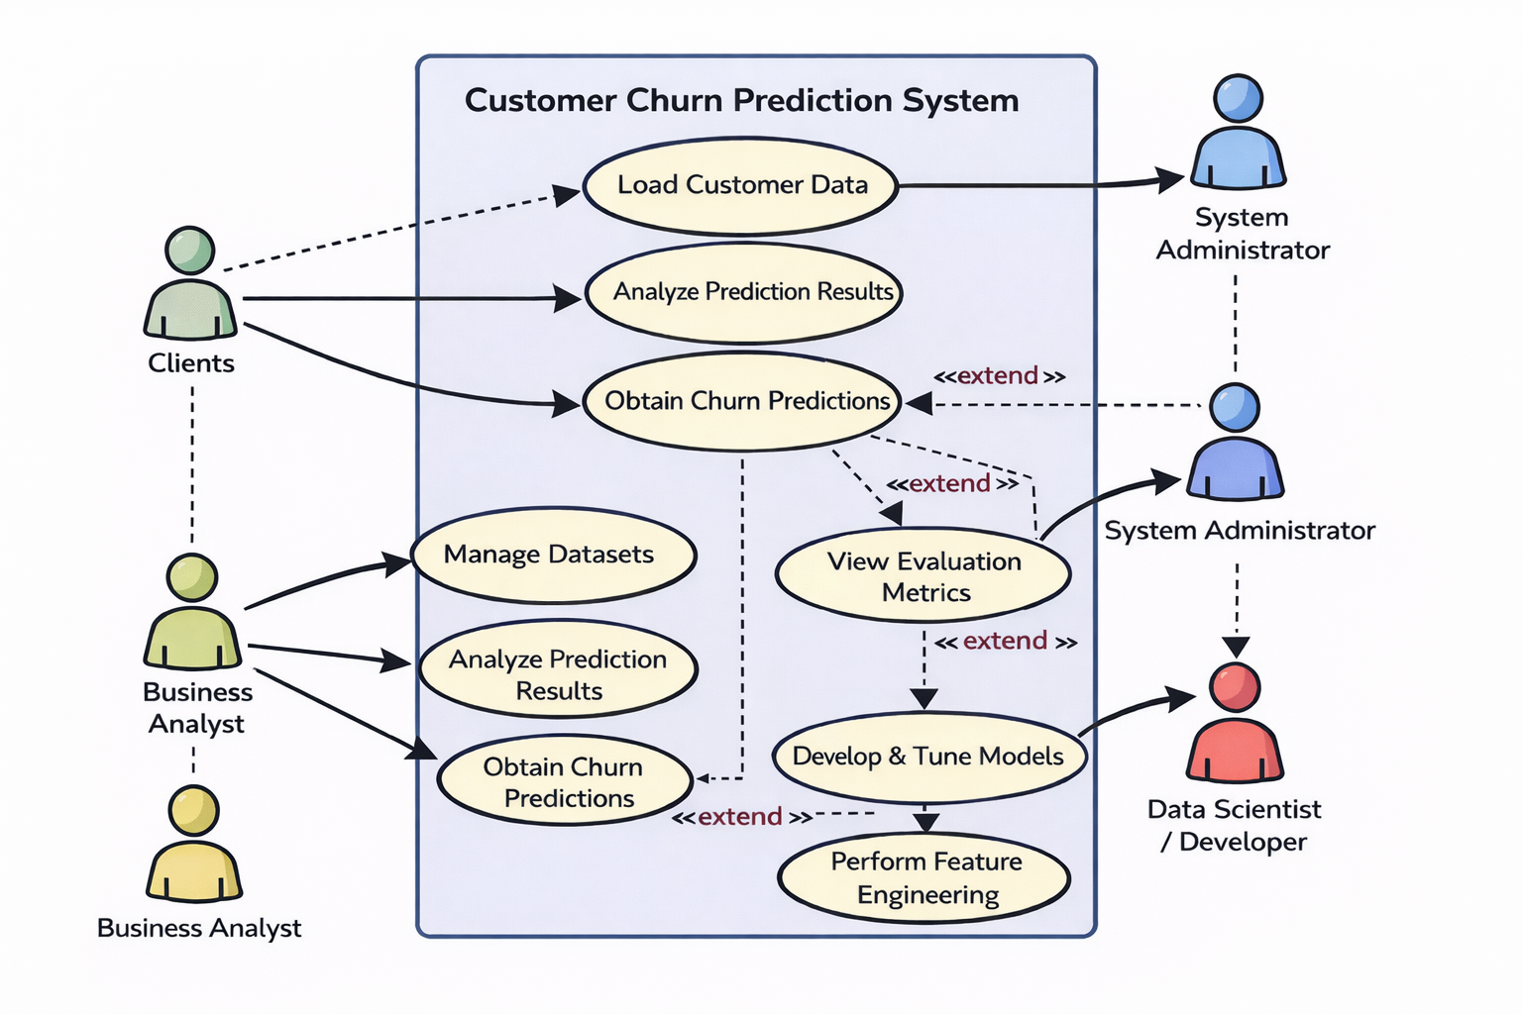
Applications
Telecom industry for customer retention
Banking and financial services for risk analysis
Subscription-based platforms (OTT, SaaS)
E-commerce customer behavior analysis
CRM systems for business intelligence

Slide 23
Conclusion
customer churn prediction system successfully demonstrates the how machine learning can be leveraged to identify potential churn customers with high efficiency.
Here Ensemble based stacking approach provided more robust and stable predictions compared to individual models.
Key business insights show that factors such as recharge type, contract type, tenure, and payment method strongly influence customer churn behaviour in initial stage of relationship building.
So, Businesses have to take decision on retention strategies, reducing revenue loss and improving customer satisfaction.

Slide 24
References
Mohammad Ridwan Ismail, Mohd Khalid Awang, M. Nordin A. Rahman, Makhtar “A Multi-Layer Perceptron Approach for Customer Churn Prediction” International Journal of Multimedia and Ubiquitous Engineering, Vol.10, No.7, 2015.
Abinash Mishra, U. Srinivasulu Reddy “A Comparative Study of Customer Churn Prediction in Telecom Industry Using Ensemble Based Classifiers” International Conference on Inventive Computing and Informatics (ICICI), IEEE, 2017.
Michael C. Mozer et al. “Predicting Subscriber Dissatisfaction and Improving Retention in the Wireless Telecommunications Industry” IEEE Transactions on Neural Networks, 2000.
Ning Lu et al. “Customer Churn Prediction in Telecom Industry using Boosting” IEEE Transactions on Industrial Informatics, 2014.

Slide 25
Thank You

